Slide 1
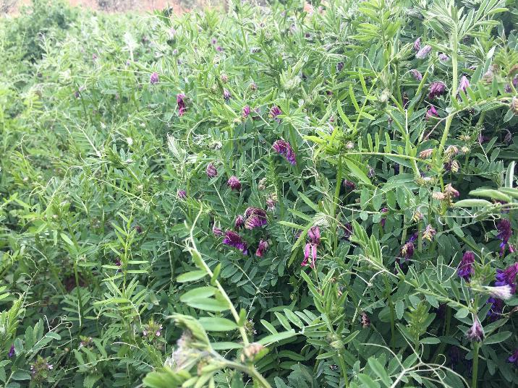
MODULE 8:
MAXIMIZE LIVING ROOTS
Notes:
This module summarizes the use of cover crops in small-scale agriculture as a strategy for improving soil health. We will focus on ways in which managing cover crops in small-scale systems is distinct from how they are managed at larger scales. We will present some key tools, methods, and use-case scenarios for cover crops in small-scale agriculture.
Photo: Josh Beniston, USDA NRCS. A hairy vetch (Vicia villosa) cover crop maturing in early spring in a vegetable production garden.

Slide 2
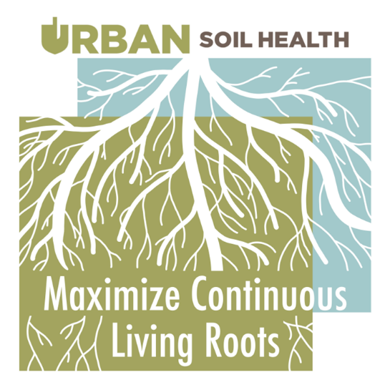
Objectives
Utilize cover cropping to effectively address soil health resource concerns in urban and small-scale agriculture.
Discuss appropriate cover crops and their associated planting and termination methods for small-scale systems
Notes:
These are the learning objectives for this module.
Image courtesy of Indiana Urban Soil Health Program

Slide 3
Cover Crops for Small-scale systems

Slide 4
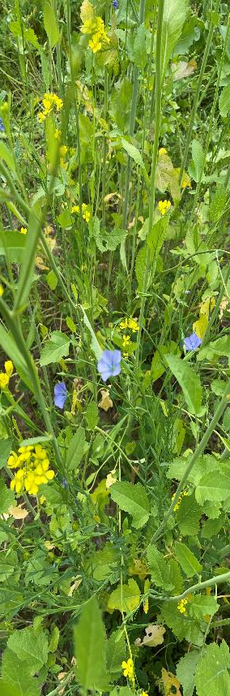
Cover Crop Benefits
What are some potential benefits of cover crops for urban and small farms ?
Notes:
Ask the group this question. Take a few responses and discuss.
Photo: Josh Beniston, USDA NRCS. A cover crop mixture with several different species growing in a backyard garden.

Slide 5
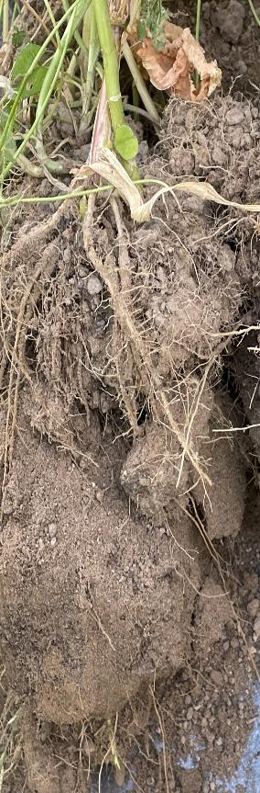
Cover Crop – Physical Effect on SH Resource Concerns
Compaction: Increased biomass and roots improve aggregation, giving better resistance to compaction.
Soil organism habitat: Live plant roots and diversity of roots improve quality of food, shelter and cover.
Aggregate instability: Live plant roots increase aggregation physically and through exudates.
Organic matter depletion: More biomass produced will increase organic matter.

Slide 6
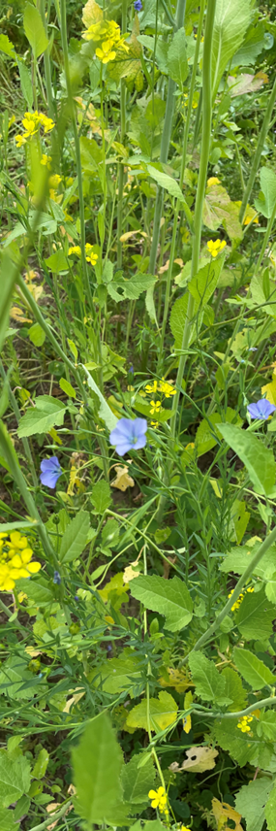
Cover Crop Challenges
What are some common challenges and obstacles to cover crop adoption and management for small-scale or urban farms ?
Notes:
Ask the group this question. Take several responses and discuss briefly.

Slide 7
Cover Crop Challenges
No space in crop plan
High value space in a high tunnel
"Not enough time” for labor
Don’t know about them
Bad experience
High biomass and residue management
“Doesn’t produce food”
Notes:
Go through list of bullet points. This list is not comprehensive but does contain some key challenges for small-scale farms.
The point of “high value space in a high tunnel” can apply to all growing spaces on small farms where it is necessary to emphasize revenue.

Slide 8
Question
What are some important questions that you need to ask a producer or client when you start a cover crop about incorporating cover crops into their system ?
Notes:
Ask the group this question. Take a few responses and discuss briefly.

Slide 9
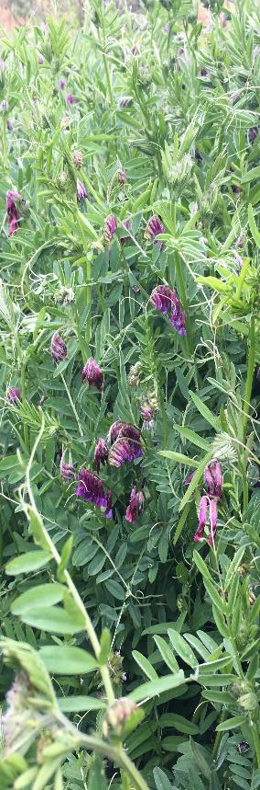
Cover Crops – Key Questions
What are your goals for a cover crop? How do hope it will enhance your system?
Are there times in the year when you don’t have crops planted?
What equipment do you have for planting cover crops?
What equipment do you have for terminating a cover crop?
How much residue will work in your system?
How will you manage water and weeds?
Notes:
Go through the list of bullet points. These questions apply to cover cropping at all scales. There are also other important questions – such as “what is your previous experience with growing cover crops?”
For beginning small-scale farmers, more explanation and technical assistance may be required related to these questions and topics.

Slide 10
Providing Technical Assistance
Provide cover crop tables, information, and resources
Recommend and discuss seeding and termination methods
Assist in selecting cover crops and designing cover crop mixes
Notes:
This slide can also start with the question – “What are some ways that we can provide technical assistance on cover cropping to small-scale growers?”

Slide 11
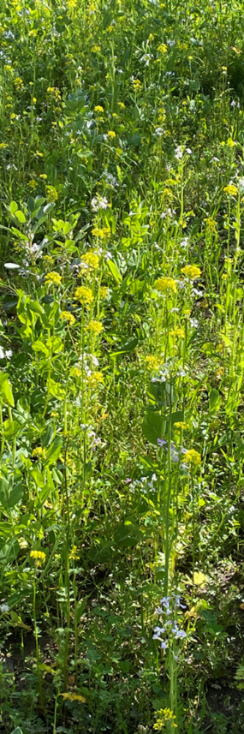
Cover Crop Selection
What plant characteristics are important to consider when choosing a cover crop to address a producer’s goals and resource concerns?
Do the plant characteristics of interest change for smaller scales ?
Notes:
Ask questions to the group and take a few responses.
Photo: Josh Beniston, USDA NRCS. A cover crop mixture maturing in spring in a commercial orchard in the Central Valley of California.

Slide 12
Cover Crop Selection
Characteristics should address identified priorities and resource concerns
Growth cycle
Growth habit
Root architecture
Growth rate
Chemical composition
Stress tolerance
Time to flowering
Pest resistance or susceptibility
Notes:
Go through list of bullet points. These are some key plant characteristics for selecting cover crops.

Slide 13
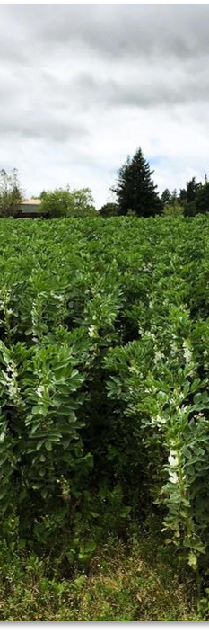
Matching Production System Factors
What other concerns can be important for determining that suitability of a particular CC or variety for a specific site?
Disease carry over
Host of cash crop pest
Residue at planting/harvest
Impact on pollinators for cash crop
Notes:
Ask group the question that begins this slide. This slide really is referencing another set of potential concerns/challenges that can arise on small-scale farms focused on vegetable or fruit production.
Disease carry over and host of cash crop pest can be significant concerns in regions of the country with significant fruit and vegetable production or in warmer climates.
Photo: Josh Beniston, USDA NRCS. A maturing bell bean (Vicia faba) cover crop in a vegetable production field in California.

Slide 14
Cover crops in small-scale systems
How is cover cropping different in small-scale systems ?
Notes:
Ask the group this question and discuss briefly.
Some key concepts that we will look at in the module are that techniques and tools are generally different for managing cover crops in small-scale systems.

Slide 15
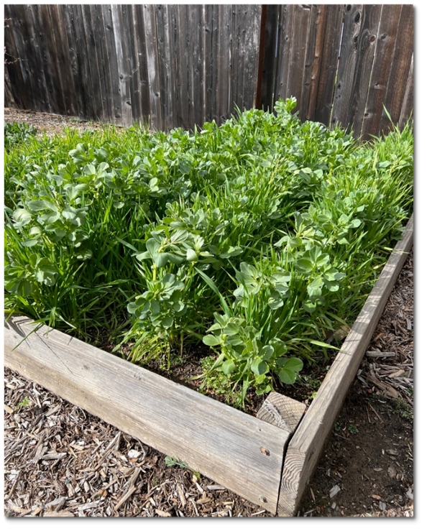
Cover crops in small-scale systems
Seeding rates (plants per sq ft)
Planting techniques
Termination methods
Tools
Management of CC
Notes:
Go through bullet points. These are key distinctions in the way that cover cropping in small-scale systems differs from larger scale systems.
Higher seeding rates for quick or more dense coverage of soil
Photo: Josh Beniston, USDA NRCS. Cover crop planting of bell beans and oats in a backyard raised bed.

Slide 16
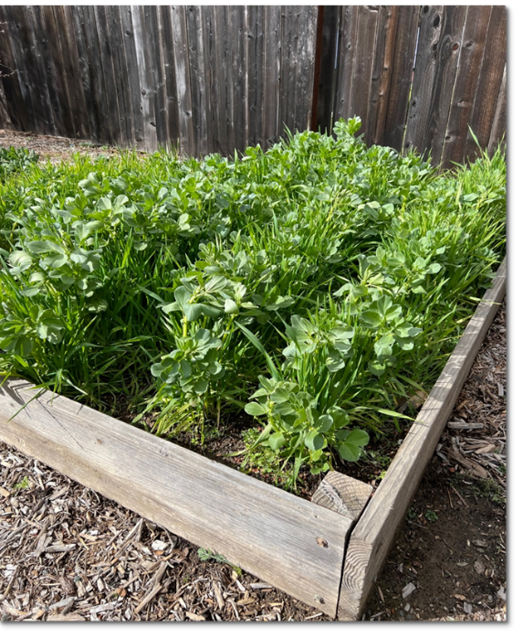
Cover Crop Planting Methods for Small-scale systems
Broadcast seeding
Furrow seeding
Push seeder
Notes:
These are three of the most common methods used to plant cover crops in small-scale agriculture systems. We will look at each option in greater detail.

Slide 17
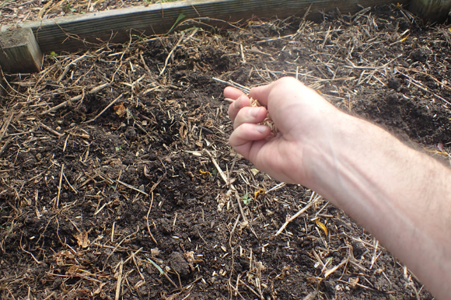
Broadcast Seeding
Spreading the cover crop seed over an area (by hand or with a seed spinner)
Potential for low seed to soil contact, patchy and uneven germination.
Useful in high residue situations where other methods aren’t practical.
Firming the bed, irrigation, and/or light mulch can increase success
Notes:
Broadcast seeding is a very common method for small-scale systems.
The second bullet point here highlights the common challenge of getting good seed to soil contact with this method.
To achieve recommended seeding rates, many people will calculate and weigh out the exact quantities of seed needed for the space. Without weighing out seed, it can be very challenging to get an accurate seeding rate.
Besides poor seed to soil contact, seed predation by birds can be a significant issue for broadcast seeding of cover crops in gardens.
Photo: Kevin Allison, Marion County Soil and Water Conservation District, Indiana.

Slide 18
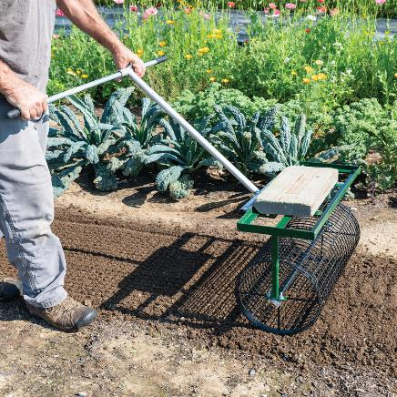
Incorporation
Spreading seed over an area and then using a tool to bury the seed to the desired depth
Results in better seed to soil contact resulting in more consistent germination
Common tools:
  Rake
  Rotary cultivator
  Tilther
  Power harrow with bed roller or rolling basket
  Tiller with bed roller or rolling basket
  Bed roller
Notes:
Incorporation, or pressing seeds into soil, is very important to successful germination of cover crops, particularly if the seed has been spread by broadcasting.
The third bullet point here goes through a list of tools that are commonly used to incorporate broadcasted cover crop seeds on small-scale farms.
Photo: https://www.johnnyseeds.com/ - A bed roller, weighted with a cement block. This tool can be used either to create a smooth bed surface for seeding, or to incorporate and press seeds into soil following broadcast seeding.

Slide 19
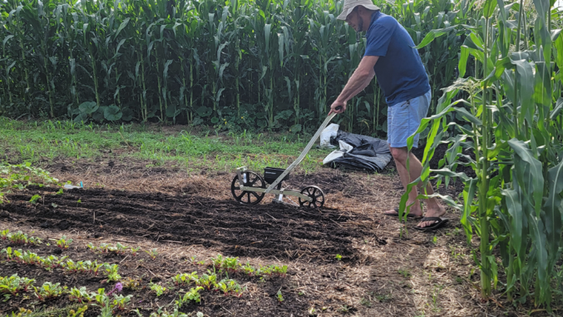
Direct Seed using Row Seeders
Direct seed to soil contact, refer to cover crop table for optimum seeding depth
Some growers might broadcast small seed and then direct seed large seed on same bed.
Can be inefficient in hard or compacted soils. Shallow seedbeds or furrows are often prepared prior to direct seeding.
Adding a light layer of compost can allow for direct seeding without disturbance.
Notes:
Row seeders are a common tool on small-scale farms and are commonly used for the direct seeding of vegetable crops. They direct seeders operate in a similar fashion as a no till drill in that it makes a furrow in the soil and drops seeds into the furrow. The seeders have plates that go inside the hopper, based on the size of the desired seed. The plates singulate the seeds and provide desired spacing. The seeder being used in the photo is an “Earthway” brand.
Some growers use this tool to achieve more precision seeding of cover crops at a garden scale. It is particularly effective for larger seeded cover crops such as peas or bell beans.
Slide and photo c/o Kevin Allison, Marion county SWCD, Indianapolis IN
“Using Manually – Operated Seeders for Precision Cover Crop Plantings on the Small Farm” document for Earthway seeders or manufacturer standards

Slide 20
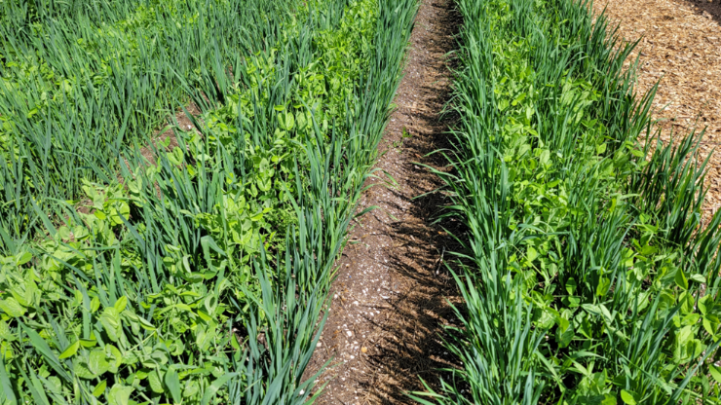
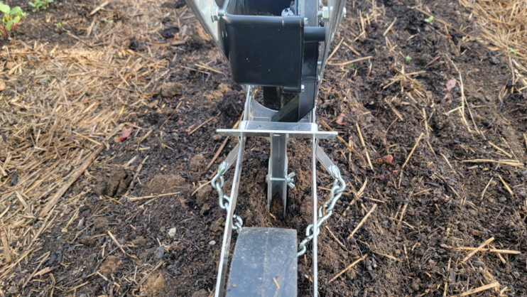
Direct Seed using Row Seeders
Notes:
Photo on the right side of the screen shows a close up the Earthway seeder from behind. The furrower, back of hopper and drag chain for closing furrow are all visible.
Photo on left side shows a growing cover crop of winter peas and oats planted with the Earthway and demonstrating good spacing and cover.
Slide and photo c/o Kevin Allison, Marion county SWCD, Indianapolis IN

Slide 21
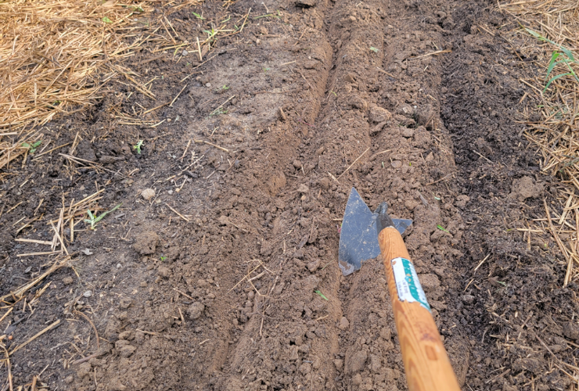
Seeding in Furrows
Furrow
Seed Cover Crop (by hand or row seeder)
Cover and Firm
Notes:
A simple and generally effective method for seeding cover crops at small-scale/garden scale is to use furrows. A garden tool, such as the triangular hoe in the photo, is used to open furrows in rows in growing beds. The seeds are then spread in the furrows, the soil is pushed back onto the furrows, and the planting is watered or irrigated. As with broadcasting, the quantities of seed must be calculated and weighed for the growing area to achieve optimal seeding densities.
Using furrows is a good choice of seeding method for beginning growers and gardeners who have not used cover crops in the past.
Slide and photo c/o Kevin Allison, Marion county SWCD, Indianapolis IN

Slide 22
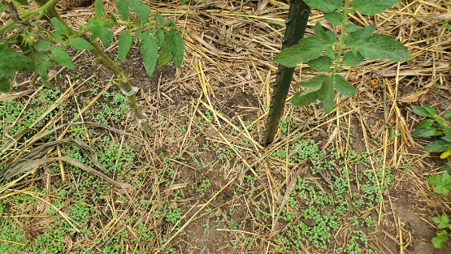
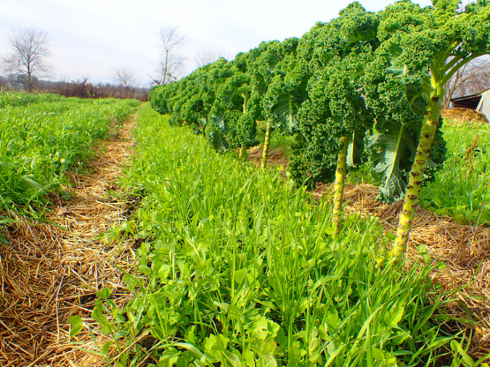
Inter-seeding
Increase time for photosynthesis, roots, and biomass.
Air flow, water, nutrients, spacing.
Inter-seeding into mature crops is more common than simultaneous plantings
Will an inter-seeded cover crop impact your harvesting?
Notes:
Inter-seeding is a more advanced cover crop planting technique. The technique is primarily used in situations where the producers wants to keep a cash crop growing past the optimal dates for cover crop establishment – so that the cover crop has time to establish while the crop is growing.
As described in the bullet points, inter-seeding into a growing or mature crop is more common than planting the cover crop at the same time as the cash crop. The photos sow a clover cover crop germinating under mature tomato plants and a growing stand of a mixed winter cover crop that was seeded while a kale crop is still growing.
Slide and photos c/o Kevin Allison, Marion county SWCD, Indianapolis IN

Slide 23
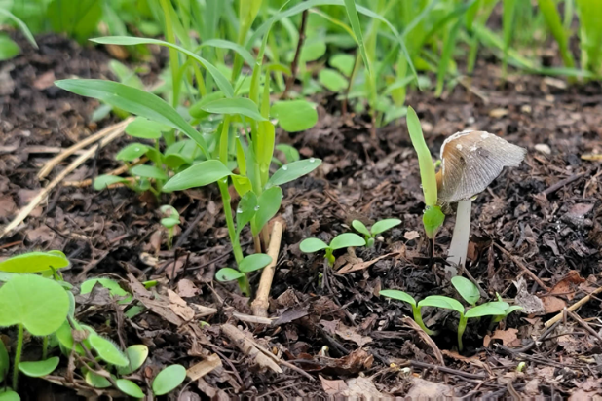
Moisture Management at Planting
Best practice is to keep bed moist through cover crop germination
One good rain is advantageous
A light layer of straw or other mulch on top of the cover crop seeding can help conserve moisture
Seed to soil contact is key
Notes:
Moisture management after planting is key to the success of a cover crop. Cover crop seeds must be watered after planting, unless there is rainfall. In dry conditions, cover crop seedlings will likely need irrigation to keep them growing.
It is important to stress this point with beginning growers and growers who are new to cover crops.
Slide and photo c/o Kevin Allison, Marion county SWCD, Indianapolis IN

Slide 24
Reasons for Seeding Failure
Germination Through Emergence
Poor quality seed
Improper timing
Temperature
Too hot!
Too cold!
Improper planting depth
Seed dries out
Crusted soil surface
Toxicity
After Emergence
Competition from weeds
Low fertility
Poor drainage
Drought
Insects
Improper grazing by livestock
Foraging by wildlife
Diseases
Winterkill
Notes:
There are many reasons why cover crop plantings can fail. Success of plantings needs to be monitored regularly during both the germination and seedling phases of growth to ensure success.
These considerations apply across all scales of growing but may be important

Slide 25
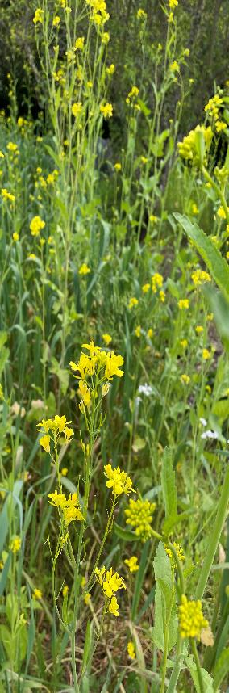
Cover Crop Termination
What methods have you observed for successful cover crop termination in small-scale systems?
Notes:
Ask the group this question for discussion and take several responses.
Termination can be a challenge in some small-scale scenarios, particularly if proper tools are not available.
Termination method is also something that many beginning growers may not have considered.
Photo: Josh Beniston, USDA NRCS. A diverse cool season cover crop in a backyard garden.

Slide 26
Cover Crop Termination Methods for Small-scale systems
Tillage – tractors or hand tools
Mowing
Crimping
Tarping
Winter Kill
Herbicide
Can be challenging with some cover crops at small scales.
Notes:
This list follows on the question in the previous slide. These are all potential methods for terminating a cover crop at small-scale. All of the these methods have pros and cons. It is best to discuss termination at the beginning of planning for a cover crop. The tools and methods that are available for termination can have an impact on the species of cover crop that is chosen.

Slide 27
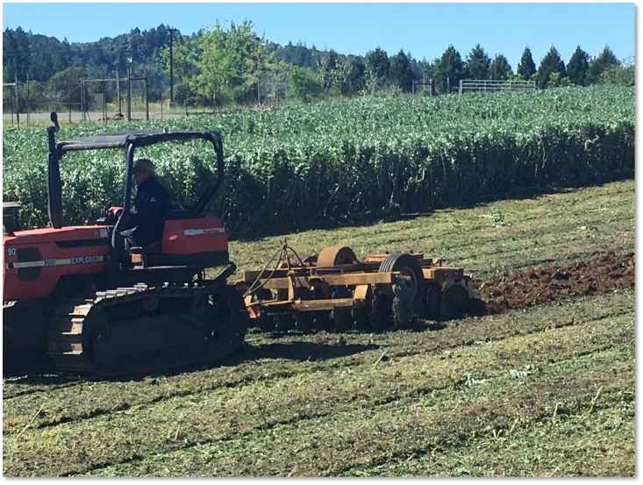
Tillage
Incorporation of cover crop.
“Green manure”
Common in organic systems.
Requires waiting period for decomposition before planting
Notes:
Tillage to incorporate a cover crop is common on organic farms, particular farms of a few acres or larger. Often the cover crop is mowed ahead of incorporation by tillage, as in the photo.
The tradition of thinking of cover crops as a green manure, generally involves tillage for termination and incorporation. Organic producers often wait a period of a few weeks after incorporating a cover crop before planting their cash crop, to allow decomposition to occur.
Incorporation of cover crops is also practiced in rows between perennial crops such as grapes and tree crops.
Legumes are often used in green manure cover crops as the decompose relatively quickly and provide some plant available nitrogen in the soil when terminated.
Photo: Josh Beniston, USDA NRCS. A cover crop of bell beans is being incorporated with a disk harrow during primary tillage before spring planting, on an organic vegetable farm. The bell beans were mowed ahead of the tillage.

Slide 28
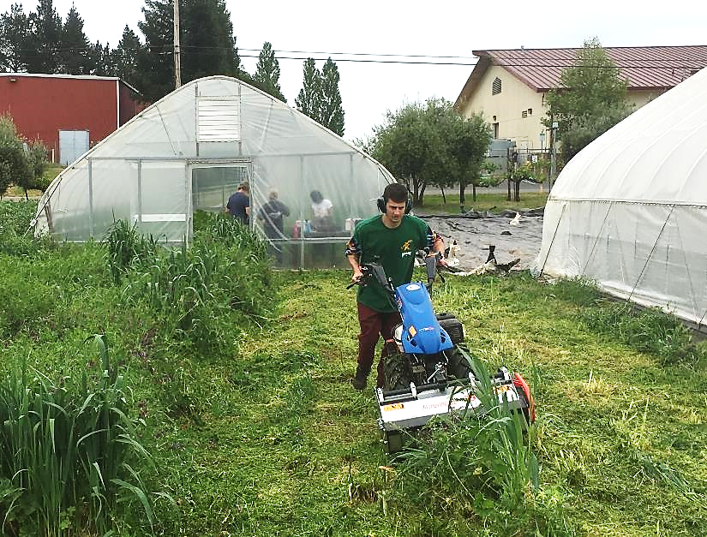
Mowing
Flail mower
Hand tools
  String trimmer
  Hedge trimmer
  Sickle
Notes:
Mowing is often done as a first step in over crop termination. Most cover crops will not be killed completely by mowing and will need a second step for full termination such as tillage, tarping, or spraying with herbicide.
A flail mower chops plants into small pieces and is very effective for mowing cover crops ahead of incorporation or tarping. Small-scale flail mowers are available on walk behind tractors, as displayed in the picture here.
At garden scale, tools such as a string trimmer, hedge trimmer or sickle can be used to chop down a cover crop.
Photo: Josh Beniston, USDA NRCS. A flail mower on a BCS brand walk-behind tractor is being used to mow a cover crop on a small-scale vegetable farm.

Slide 29
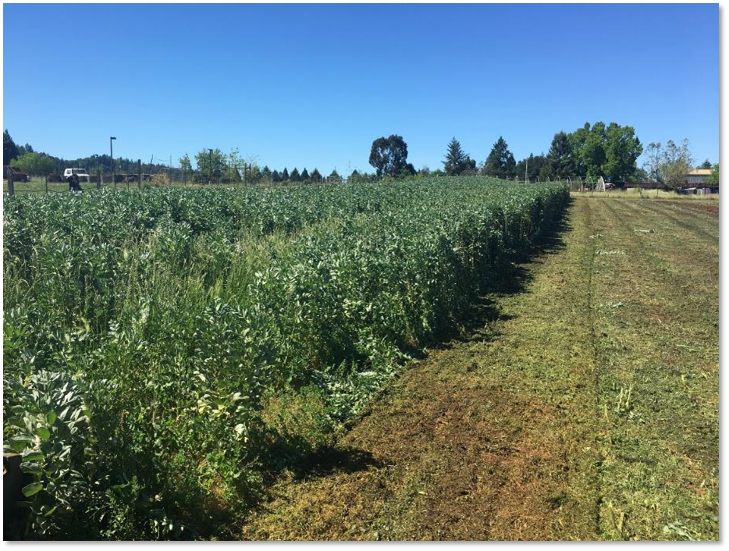
Photos of mowed vs not mowed cover crop
Notes:
A mowed cover crop of bell beans on an organic vegetable farm. The area on the right side of the photo has just been mowed with a flail mower. The photo illustrates the ability of a flail mower to chop a mature cover crop into a thin layer of biomass on the soil surface.
Photo: Josh Beniston, USDA NRCS.

Slide 30
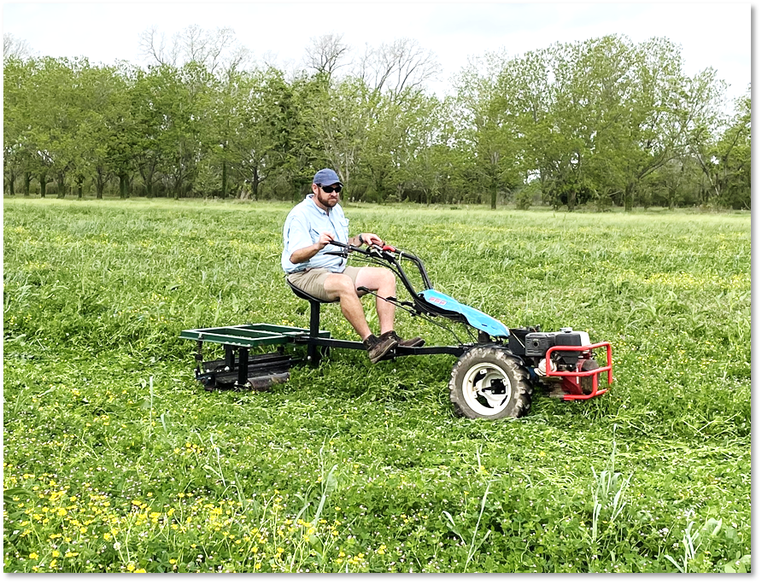
Crimping
Roller Crimper
Hand-scale Crimper
Snaps or “crimps” stems of plants.
Timing is critical.
Not suitable for all CC species or systems.
Notes:
Crimping is a method of terminating cover crops that works by snapping the stem of the plants. Generally crimping is most effective when it is applied to cover crops at a particular growth stage near maturity. Crimping has been developed as a method of cover crop termination primarily in organic systems. It can allow producers to terminate a cover crop and retain the reside on the soil surface, without using herbicide and without disturbing the soil via tillage. It is part of a suite of techniques being developed to reduce soil disturbance in organic systems or under the “organic no-till” umbrella.
There are roller crimpers that are used with tractors. The photo shows a roller crimper designed by USDA ARS engineers to be used with a walk behind tractor. Roller crimpers are generally a metal drum with straight pieces of metal on them that are pressed into the surface of the soil to snap the stems. The crimper in the photo is spring loaded to snap it against the planting.
Roller crimping is a tricky practice and is not effective in all climates, with all cover crops, without the proper tools, or at the wrong stage of a plant’s growth cycle. Best to approach with some caution and to encourage producers to try crimping on a small area before choosing to rely on it as a termination method.
Photo: Josh Beniston, USDA NRCS.

Slide 31
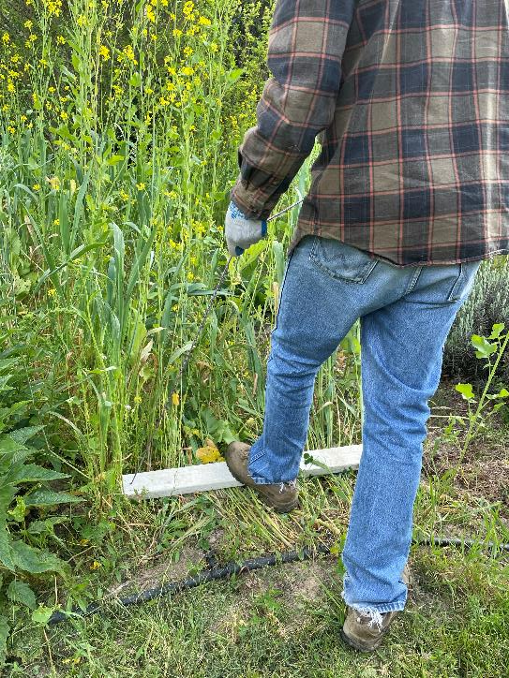
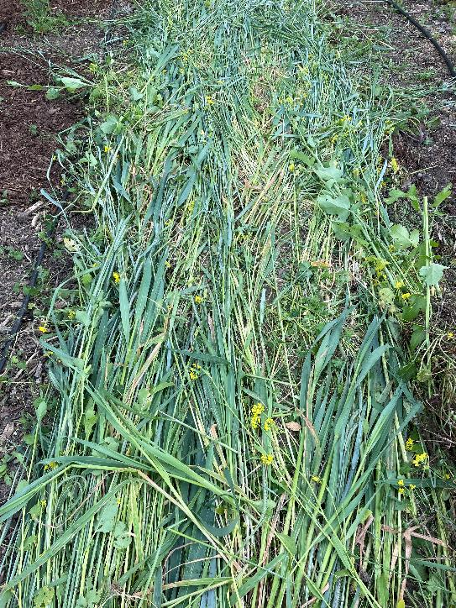
Crimping - Backyard
Notes:
In recent years, small-scale producers and gardeners have developed a method of crimping that can be done with hand tools. The photo shows a home-built crimper made from a 2x4 board with two pieces of angle iron screwed to the bottom of the board. The board also has a rope that is attached to both ends and is held in the hands like a handle. The operator places the device low on the side of the cover crop plants and steps on it to push the plants down. The angle iron pushes against the plant stems and snaps them. Variations of this tool can be built and there are youtube videos demonstrating how to make the tool.
In the photos on the slide, the crimping tool was very effective for crimping a diverse cool-season cover crop mixture that included oats and mustards. The crimping allowed for a large amount of biomass to be placed on the soil surface. The phots show the same garden bed during and after the crimping process.
Full termination was achieved in this process by covering these beds with tarps after the crimping.
Photos: Josh Beniston, USDA NRCS.

Slide 32
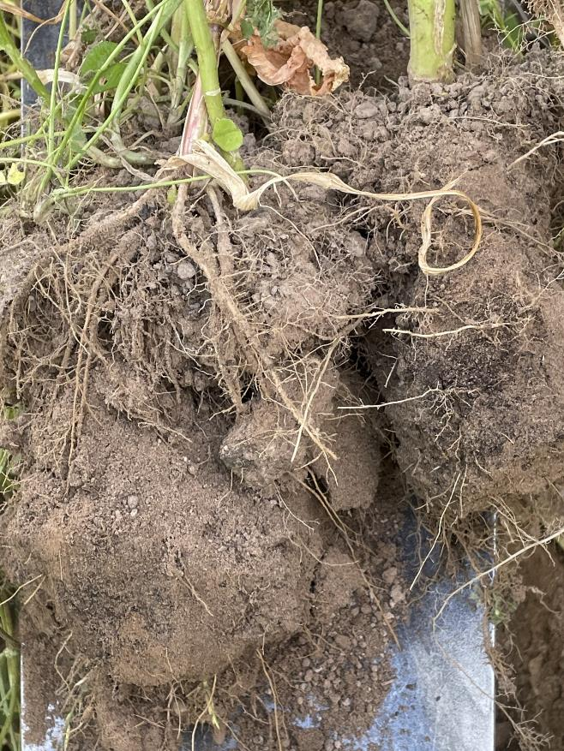
Notes:
A soil slice showing the root biomass of the cover crop in the previous slide with crimping. The diverse cover crop mixture provided a diversity of root types and made an immediate impact on the structure and aggregation of this sandy loam soil.
Photo: Josh Beniston, USDA NRCS

Slide 33
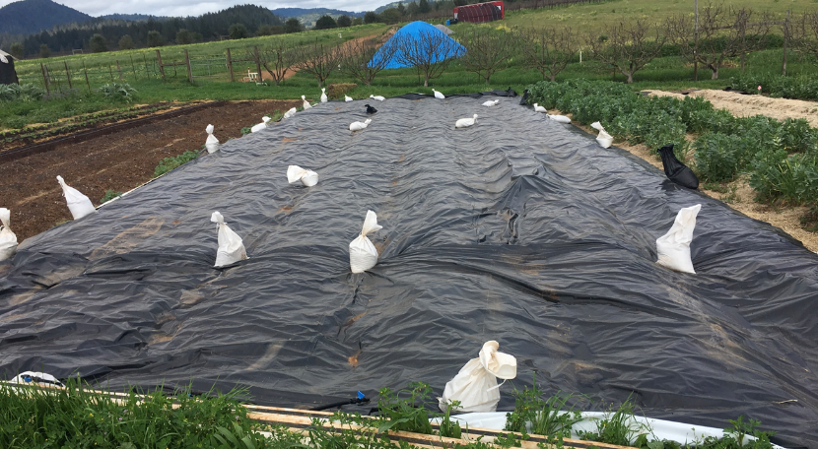
Tarping
Cuts off sunlight from plants and kills them
Often follows mowing or crimping
Silage tarps
Landscape fabric
Approx 1 month of cover required for full termination.
Notes:
Tarps are tool that has become more popular for cover crop termination on small-scale farms. The tarp cuts off the sunlight to the plant, which kills it.
Bullets above describe well.
NRCS note: Tarping = mechanical weed control with plastic or tarps in scenarios
Photo: Josh Beniston, USDA NRCS. Silage tarp is used for termination of a cool season cover crop at a site with permanent beds.

Slide 34
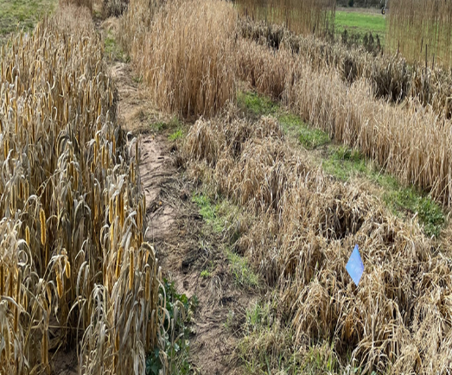
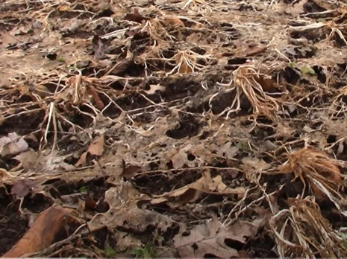
Winter Kill
Late summer plantings of CCs that are not winter hardy.
Provides winter cover of residue and allows for early spring management.
Notes:
Winter kill, or allowing plants that are not hardy to be killed by cold frosts/weather, is a strategy for terminating cover crops.
A winter kill cover crop would generally either be a warm season cover crop that was allowed to grow into the fall, or cold temperatures.
OR a cool season cover crop that is not winter hardy in a particular area, that is typically planted early in the fall or late summer to give it time to mature before freezing weather arrives.
Winter kill cover crops have the benefit of not requiting a lot of labor for termination. They can require additional mowing or cutting down of plant residues. Some winter kill cover crops provide good reside cover during the winter and spring, while others do not.
This termination and cover crop planning strategy may be effective for small-scale growers who are new to cover cropping or don’t have a lot of tools for termination. It may also be beneficial in scenarios where growers want to start their cash crops early in the spring and don’t want to deal with termination or heavy residue cover.

Slide 35
Small-scale Cover Cropping Scenarios

Slide 36
Backyard Raised Bed
Objective: “Can I plant a cover crop in my raised bed garden?”
Resource Concerns:
  Soil Organism Habitat Loss
Notes:
Many urban and backyard gardeners may not be very familiar with the cover cropping practice.
Also, raised bed gardens filled with a mixture of potting soil, compost, and/or mineral soil may have soil organism habitat resource concerns, primarily if they are only growing vegetables during the warm season, removing crop residues, and leaving the garden fallow during the cool season.
Ask class participants how they would address this situation with a cover crop and take one or two responses.

Slide 37
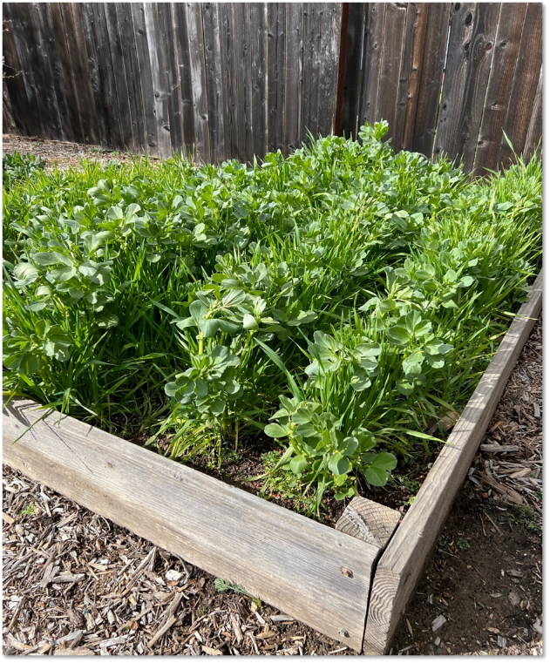
Backyard Raised Bed
Notes:
Cover cropping can work quite well in small-scale, constructed raised bed gardens. The photo shows a winter cover crop of oats and bell beans, growing in a backyard garden in California. This cover crop was planted by making furrows in the soil surface and planting into those furrows.
Photo: Josh Beniston, USDA NRCS

Slide 38
Backyard Raised Bed – Termination and Planting
Notes:
This series of photos documents the process of terminating the cover crop and transitioning the bed to spring vegetable crops, using only small-scale hand tools.
The process begins in the upper left corner. The cover crop is cut down with hedge shears, and the residue is laid on the soil surface. In the upper right corner, a piece of landscape fabric is placed over the bed for approximately a month to kill the cover crop in a “tarping process”. After the tarp is removed, significant crop residue remains (bottom left photo). This residue is moved aside to clear the soil surface for planting spring vegetables via transplanting (bottom center photo). Finally, the remaining cover crop residue is used as a mulch for the growing vegetable crop (bottom right photo).
Photos: Josh Beniston, USDA NRCS.

Slide 39
Winter Cover Crop
Before Vegetable Crops
Objective: Beginning small-scale vegetable producer would like to try cover cropping to improve their soil health. They do not have a lot of equipment for termination and do not want a high amount of residue to carry into the growing season.
Resource Concerns:
  Soil Organism Habitat Loss
  Organic Matter Depletion
Notes:
Go through information in slide and ask class participants how they would handle this situation with a cover crop.

Slide 40
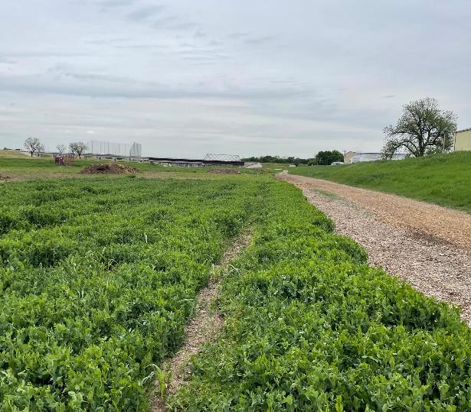
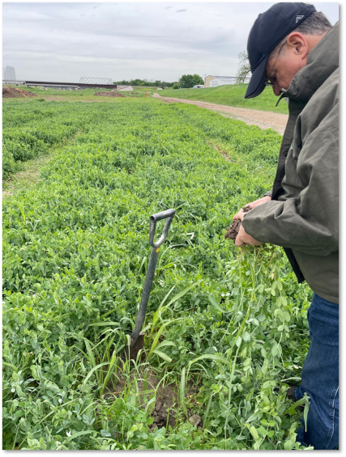
Winter Cover Crop
Before Vegetable Crops
Notes:
The cover crop in the photo is primarily winter pea. This is a good choice for the scenario, in this climate of Fort Worth TX, because it produces significant biomass and provides excellent cover during the winter. It also provides atmospheric Nitrogen – Regional Soil Health Specialist Willie Durham is observing root nodules on the peas in the photo on right. Winter peas are also relatively easy to kill – they do not regrow well after mowing and while they produce a lot of residue, it breaks down quickly. In cold climates, winter pea will winter kill, which can also be beneficial for producers new to cover cropping.
Photos: Josh Beniston and Michael Higgins, USDA NRCS

Slide 41
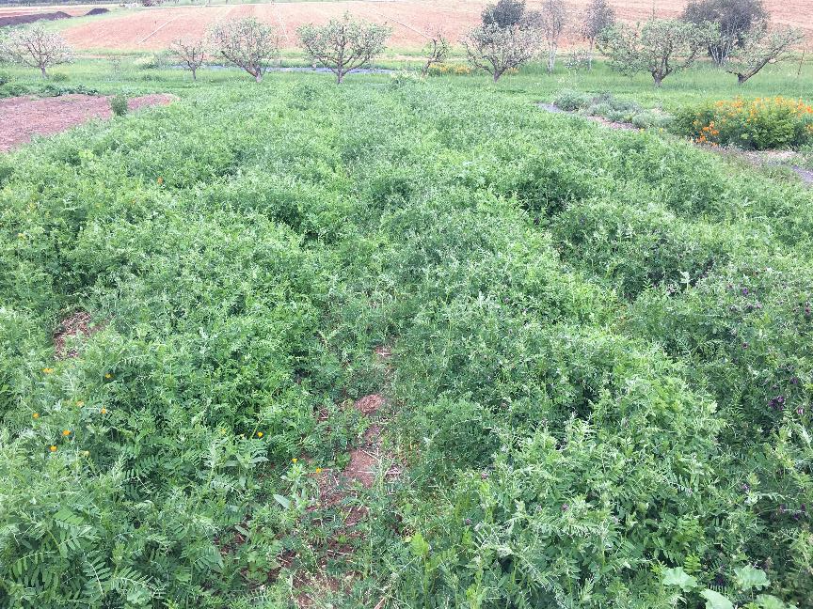
Winter Cover Crop
Before Vegetable Crops
Notes:
This photo shows a winter cover crop of vetch in a small-scale garden. Vetch also achieves the goals of providing excellent cover and residue that breaks down relatively quickly. Vetch can be harder to terminate than the winter peas, however. This vetch cover crop was terminated by flail mowing and then covering with a silage tarp.
Photo: Josh Beniston, USDA NRCS.

Slide 42
Heavily Compacted Urban Soil
Objective:
  New urban garden.
  Houses demolished on site in previous year.
  Topsoil removed during demolition.
  Soil screening indicates heavy metal contamination is not a concern.
Resource Concerns:
  Compaction (severe)
  Organic Matter Depletion
  Aggregate Instability
  Soil Organism Habitat Loss

Slide 43
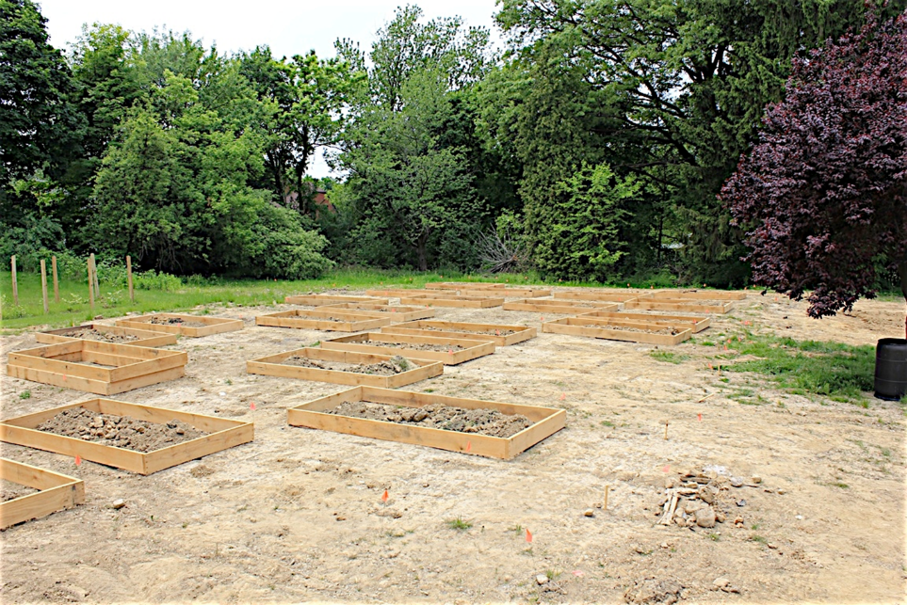
Heavily Compacted Soil - Before
Notes:
This site was used as a formal research trial for evaluating soil health management for urban agriculture in Youngstown, OH, circa 2010 – 13.
Two residential homes were previously demolished at the site and the desire was to use the site as an urban garden and greenspace. The two lots with the research garden were adjacent to a few other lots being used as a community garden.
The research project evaluated the use of shallow constructed raised beds, heavy compost application, compost + biochar, and compost + intensive cover cropping – as low-cost methods for restoring soil health and supporting urban agriculture at the site.
https://onlinelibrary.wiley.com/doi/full/10.1002/ldr.2342
This photo was taken in early May, at the time when the research garden was being constructed. The photo shows the organic matter depleted soil at the site. The soil was heavily compacted at this time and had extensive crusting. It was not clear that vegetable plants were going to be able to grow in the ground at the site at the time that this photo was taken. Bulk density measurements taken at this time averaged 1.8 g cm3 across the site, which is indeed to compact for plant growth.
Photo: Josh Beniston, USDA NRCS

Slide 44
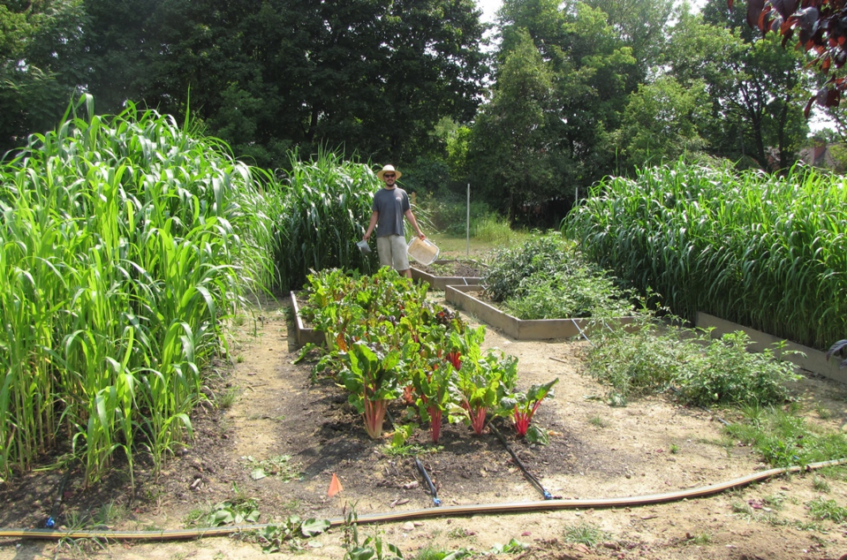
Intensive Cover Cropping in Compacted Urban Soil
Notes:
This photo was taken approximately 2 months later in July. The swiss chard plants in the foreground are growing in a plot that was amended with compost. The tomatoes next to them are in an unamended control plot.
The tall grass is a cover crop – Ask participants if they know what plant this is and take a couple of responses.
It is sorghum sudangrass. During the first growing seasons, one of the treatments was to amend the soil with compost and then plant sorghum sudangrass during the summer. Sorghum sudangrass was chosen because sudangrass was found to be the most effective cover crop for remediating soil compaction in a study done by Cornell University Extension in the late 1990s, see link below.
https://news.cornell.edu/stories/1997/07/cornell-researchers-seek-biological-approach-revitalize-compacted-and-poor-quality
Photo: Josh Beniston, USDA NRCS

Slide 45
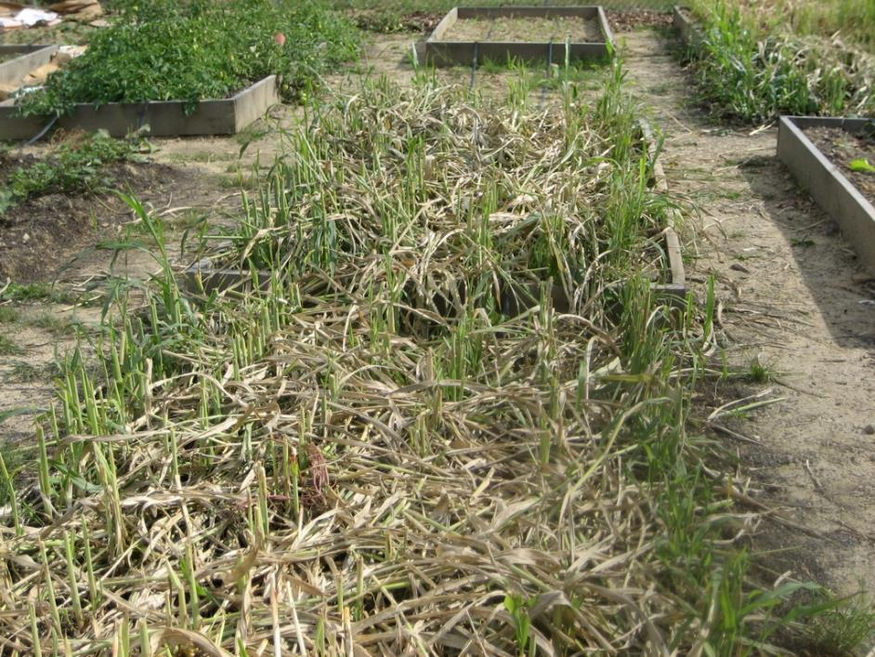
Intensive Cover Cropping
Plot Type | Yield (tons per acre)
In Ground | 4.7
Raised Bed | 4.2
Sorghum bicolor X S. bicolor var. sudanese
Notes:
The sorghum sudangrass cover crop produced a tremendous amount of biomass during that summer. It was cut down or mowed twice with a gas powered hedge trimmer and the biomass was retained on the plot. Measured estimates of the total amount of aboveground biomass produced by the sorghum sudangrass are in the table above. This is a significant amount of carbon added to this soil with the addition of the cover crop.
Photo: Josh Beniston, USDA NRCS

Slide 46
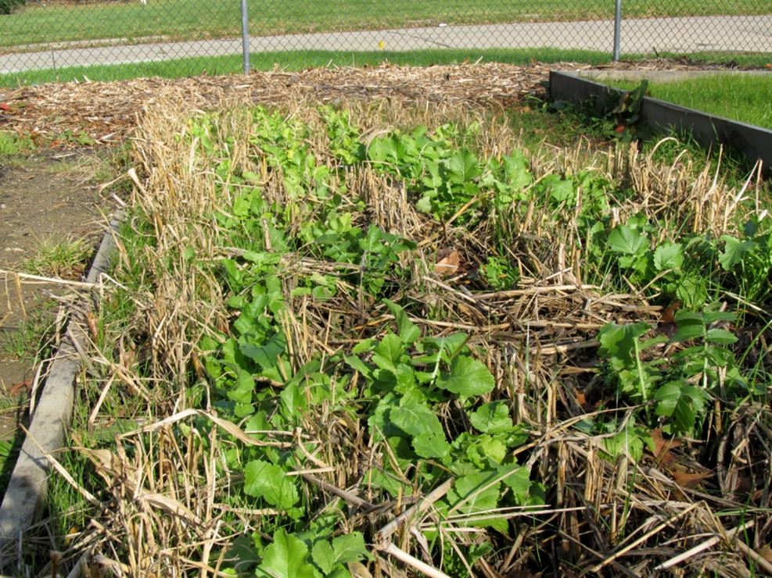
Compacted Soil – Inter-seeding
Notes:
The intensive cover crop treatment was managed for a full calendar year. The sorghum sudangrass was terminated with winter kill. It does not tolerate hard frost. Tillage radishes were interseeded into the sorghum sudangrass in the weeks leading up to the frost. This photo was taken in the fall and shows the tillage radishes growing in between the rows of winter killed sorghum sudangrass.
Photo: Josh Beniston, USDA NRCS

Slide 47
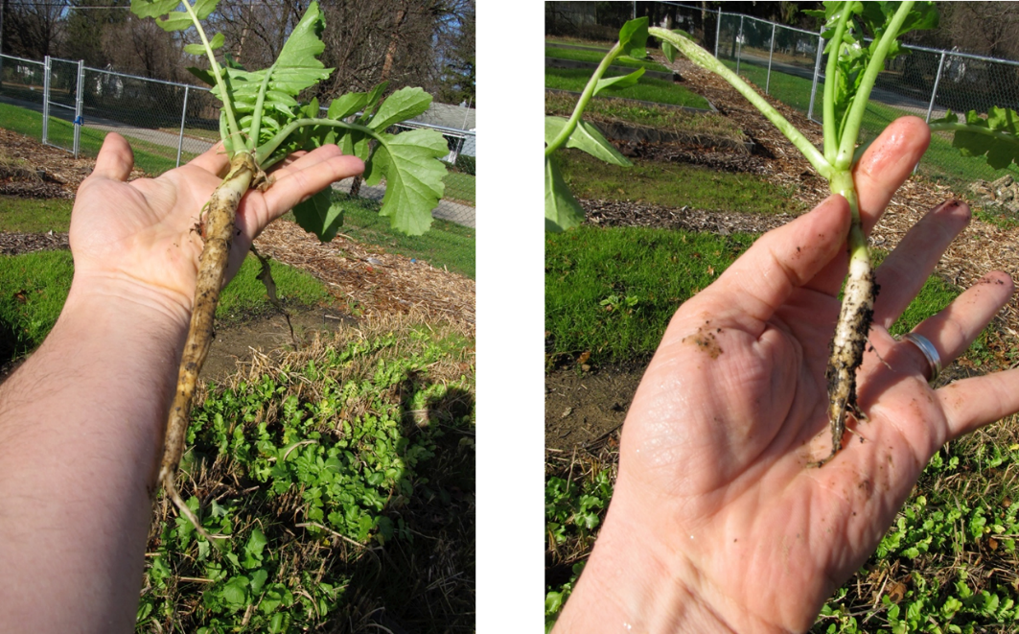
Compacted Soil – Tillage Radish
Notes:
The tillage radishes produced tap roots that were several inches long in the raised bed plots (left photo) and a few inches long in the in-ground plots (right photo) – this was despite the heavily compacted baseline conditions at the site.
Photo: Josh Beniston, USDA NRCS

Slide 48
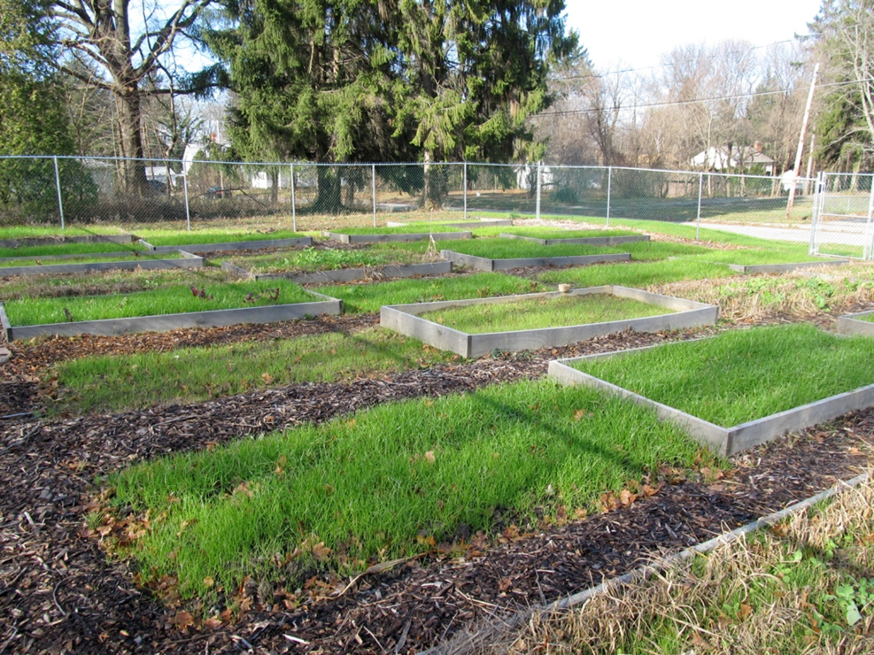
Compacted Soil – Winter cover
Notes:
The final planting in the intensive cover cropping treatment was a winter cover crop of annual ryegrass. This cold hardy cover crop continued growing through the winter, after the tillage radishes were also winter killed by the cold temperatures. This photo was taken in late November.
The annual ryegrass was terminated by mowing followed by tillage incorporation with a rototiller in the spring.
Photo: Josh Beniston, USDA NRCS

Slide 49
Soil properties
(following two years of management)
All organic matter treatments resulted in significant improvement to most soil properties, including:
  4-5 times increase in total soil Carbon
  30 times greater microbial biomass C (MBC)
  30% reduction in bulk density
  60% increase in % water stable aggregates (%WSA)
  4-5 times increase in total soil Nitrogen
  3 times increase in Phosphorous and 4 times increase in Potassium (Mehlich 3)
There were few differences in soil properties among the 3 OM treatments.
Notes:
This is a summary of the soil property measurements that were taken at the site two years after the treatments were initially applied. The intensive cover cropping treatment grew throughout year one of the trial.
Data from
https://onlinelibrary.wiley.com/doi/full/10.1002/ldr.2342

Slide 50
Aggregate Mean Weight Diameter (MWD)
b
ab
ab
MWD (mm)
a
Treatments
Notes:
One soil property that did show statistical differences among the treatments was the soil aggregate mean weight diameter, which is a measure of the size of water stable soil aggregates.
The intensive cover cropping treatment displayed soil aggregates that were significantly larger than the control at the site, demonstrating that this treatment was able to achieve measurable improvements to the soil structure over a relatively short period of time.
Abbreviations: CNT = Control, CMP = Compost only treatment, CMP +B = Compost + biochar treatment, CMP + ICC = Compost + intensive cover cropping treatment, GR = In-ground plots, and RB = Raised bed plots

Slide 51
Year 2 Crop Yields
a. Tomatoes
b
b
b
b
a
a
Yield (kg m⁻²)
b. Sweet Potatoes
b
b
b
b
a
a
Treatments
Tomatoes 6-59% of average on farm yields in Ohio (2006-2009)
Sweet potatoes slightly increased compared to on farm yields (2007-2010).
USDA National Agricultural Statistics.
Notes:
Crop yields at the site were greater in raised beds, compared with in ground plots.
The organic matter treatments all had higher yields than the control plots, but did not differentiate among treatments. There was however a clear trend in both crops in year two that the intensive cover cropping treatment appeared to have slightly higher yields than other treatments.
Abbreviations: CNT = Control, CMP = Compost only treatment, CMP +B = Compost + biochar treatment, CMP + ICC = Compost + intensive cover cropping treatment, GR = In-ground plots, and RB = Raised bed plots

Slide 52
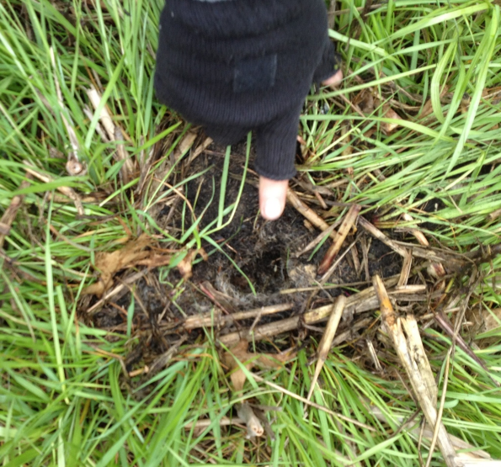
Intensive Cover Cropping in Compacted Soil
Notes:
This photo shows a root channel that was created by the tillage radish cover crops. The vigorous roots of the annual ryegrass, which is still growing in this photo, have followed the tillage radish channel.
Photo: Josh Beniston, USDA NRCS

Slide 53

Questions and Review
Question ?
Comments ?
Concerns ?
Thank you

Slide 54

This information is provided as a public service and constitutes no endorsement by the United States Department of Agriculture or the Natural Resources Conservation Service of any service, supply, or equipment listed.
While an effort has been made to provide a complete and accurate listing of services, supplies, and equipment, omissions or other errors may occur and, therefore, other available sources of information should be consulted
The USDA is an equal opportunity provider and employer.
Meeh, NRCS

Slide 56
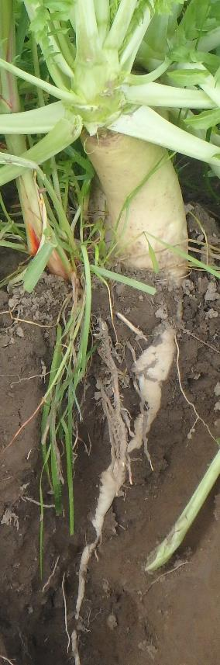
Importance of Living Roots
HOW DOES CONS CROP ROTATION SUPPORT THIS PRINCIPLE???
Reduces sheet and rill erosion
Reduces wind erosion
Provides above ground biomass, shelter, pollinator forage, wildlife food source
Provides continuous live roots and builds below ground biomass
Roots grow and cycle during the practice life span contributing exudates, stimulating soil biota, recycling nutrients
Plants remove residual soil nutrients within the top foot of soil and recycle nutrients, add organic matter.

Slide 57
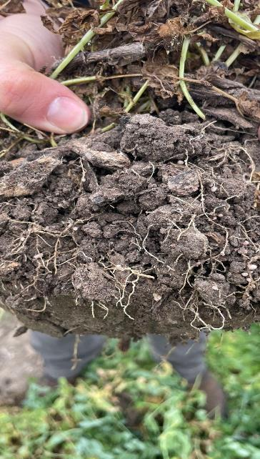
Cover Crop Purposes
Reduce erosion from wind and water.
Increase soil organic matter content.
Capture and recycle or redistribute nutrients.
Promote biological nitrogen fixation
Increase biodiversity.
Suppress Weeds.
Manage soil moisture.
Minimize and reduce soil compaction.
Do all of these apply at small scales ?

Slide 58
Cover Crop Purposes
Do these apply well at small scales ?

Slide 59
Cover Crop Selection Tools
What resources do you use to help select cover crop species?

Slide 60
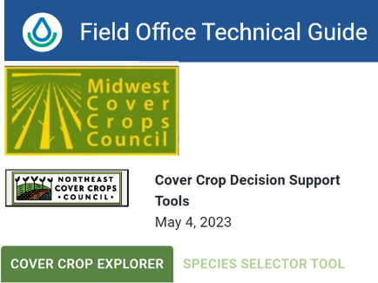
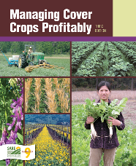
Cover Crop Selection Tools
Utilize available planning tools
Start with state specific resources
Indiana Small-Scale Tools/Guides
Plant Materials Centers
Cover Crop Council Tools
  Cover Crops Decision Tool
  Species Selector Tool
  Cover Crop Explorer
  Cover Crop Nitrogen Calculator
Industry resources

Slide 61

Mixes
Blend to address resource concerns
Include species from different functional groups
Notes:
Can be more challenging than beneficial if not done well

